Slide 1



Supervised Learning Classification
INTRODUCTION TO MACHINE LEARNING
- Ashwina Rakish

Slide 2
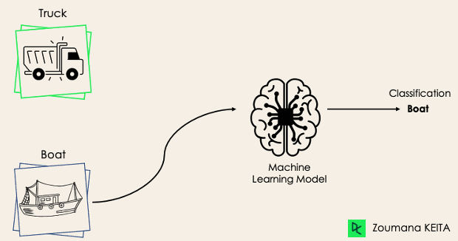
Classification
Classification is a supervised machine learning method where the model tries to predict the correct label of a given input data. It classifies each instance into a particular category
The predicted variable is a discrete categorical value.

Slide 3
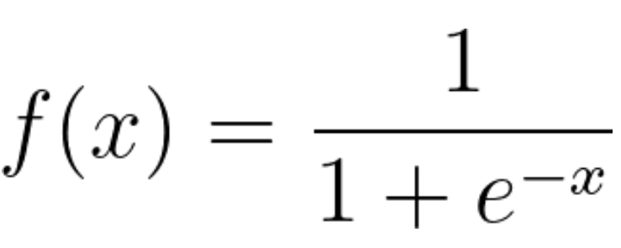
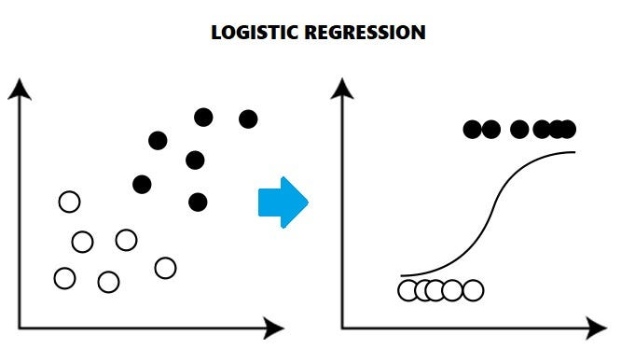
Logistic Regression
The predicted variable is a discrete categorical value. Logistic regression estimates the probability of an event occurring, based on a given data set of independent variables. It uses the logistic/sigmoid function to estimate probability
The threshold in logistic regression refers to the value used to classify the predicted probabilities into discrete class labels. When the predicted probability exceeds the threshold, typically set at 0.5 by default, the observation is classified into one class (e.g., class 1); otherwise, it is classified into the other class (e.g., class 0).

Slide 4
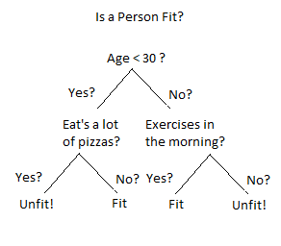
Decision Trees
Decision trees work by recursively partitioning the input space into smaller regions, making decisions at each step based on the values of input features. They are highly interpretable, as the decision-making process can be easily visualized. They can handle both numerical and categorical data and are robust to outliers and missing values. However, they tend to overfit noisy data, which can be mitigated using techniques like pruning or ensemble methods like Random Forests or Gradient Boosting.

Slide 5
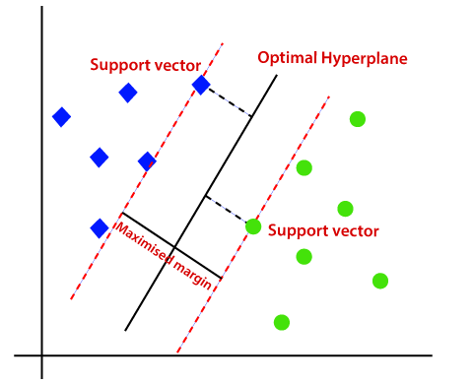
Support Vector Machines
Support Vector Machines (SVM) is a machine learning algorithm used for classification and regression tasks. It finds the optimal hyperplane that separates data into classes with the largest margin. SVM can handle non-linear data. It's effective for high-dimensional data and widely used in applications like text classification and image recognition.

Slide 6
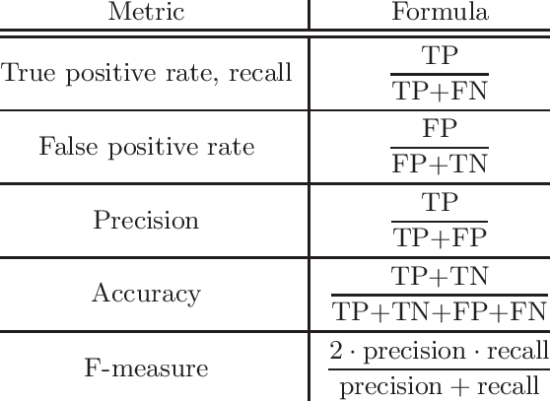
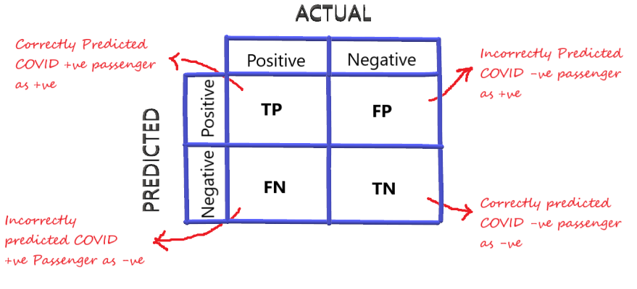
Evaluation Metrics
Confusion Matrix

Slide 7
QUIZ

Slide 8
Question: In a security screening at an airport, a passenger not carrying any prohibited items is flagged.
Answer: False Positive

Slide 9
Question: In a spam email filter, a spam email is correctly identified as spam.
Answer: True Positive

Slide 10
Question: In a test for a genetic disorder, an individual tests negative and does not carry the gene associated with the disorder.
Answer: True Negative

Slide 11
Question: In a plagiarism detection system, an original piece of work is incorrectly flagged as plagiarized.
Answer: False Positive

Slide 12
Question: In a cybersecurity system, a sophisticated malware attack goes undetected by the antivirus software.
Answer: False Negative

Slide 13
Question: In a spam email filter, a legitimate email is correctly identified as not spam and is delivered to the inbox.
Answer: True Negative

Slide 14
Question: In Covid 19 test a patient tests negative but the patient is infected by the virus.
Answer: False Negative

Slide 15
Question: In a security system, an intruder is detected and the alarm rings.
Answer: True Positive

Slide 16
Question: In a software system detecting fraudulent transactions, a legitimate transaction is flagged as fraudulent.
Answer: False Positive

Slide 17
Question: In a classification system for predicting if picture is of a cat or dog, considering cat as positive and dog as negative, TP = 1984, FN = 447, FP = 336, TN = 107. Draw confusion matrix. Calculate accuracy, precision and recall.

Slide 18
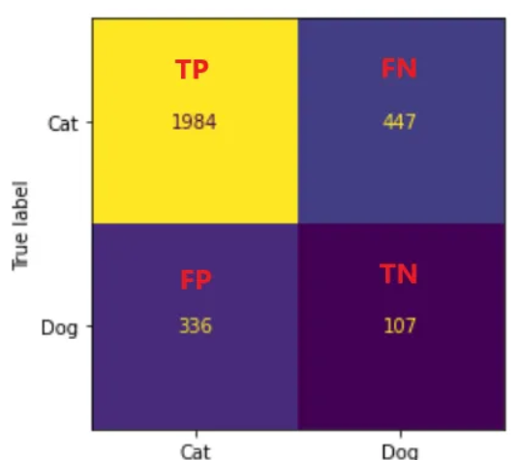

Slide 19
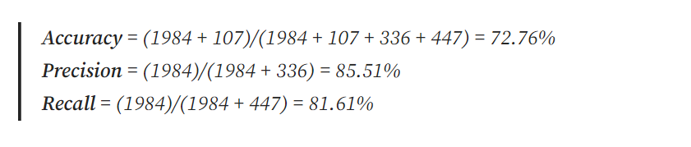

Slide 20
Question: How many cats and dogs are there according to the prediction.
Answer: TP + FP, TN+FN
2326 cats and 554 dogs.

Slide 21
Question: How many cats and dogs are there in the actual dataset.
Answer: TP + FN, FP+TN
2431 cats and 443 dogs.

Slide 22
Thank You!

